Slide 1
Intro to Infrastructure as Code
Introduction to Chef
POSSCON – April 2015
http://bit.ly/posscon2015-chef

Slide 2


Nathen Harvey
Community Director at Chef
Co-host of the Food Fight Show
Co-organizer of DevOpsDC meetup
Occasional farmer – http://bit.ly/farmer-nathen
Love Eggs – http://eggs.chef.io
@nathenharvey
nharvey@chef.io

Slide 3
Hello!
System Administrator?

Slide 4
Hello!
System Administrator?
Developer?

Slide 5
Hello!
System Administrator?
Developer?
Ruby developer?

Slide 6
Hello!
System Administrator?
Developer?
Ruby developer?
DevOp?

Slide 7
Hello!
System Administrator?
Developer?
Ruby developer?
DevOp?
Business Person?

Slide 8
Are you experienced?
Experience with Infrastructure as Code or Configuration Management?

Slide 9
Are you experienced?
Experience with Infrastructure as Code or Configuration Management?
Experience with Chef?

Slide 10
Which version control system do your use?

Slide 11
Which version control system do your use?
cp foo foo.bak

Slide 12
Which version control system do your use?
cp foo foo.bak
cp foo{,.`date +%Y%m%d%H%M`}

Slide 13
Which version control system do your use?
cp foo foo.bak
cp foo{,.`date +%Y%m%d%H%M`}
cp foo{,.`date +%Y%m%d%H%M`-`$USER`}

Slide 14
Infrastructure as Code

Slide 15
The Sys Admin’s Journey
ssh

Slide 16
The Sys Admin’s Journey
ssh
Store notes in ~/server.txt

Slide 17
The Sys Admin’s Journey
ssh
Store notes in ~/server.txt
Move notes to the wiki

Slide 18
The Sys Admin’s Journey
ssh
Store notes in ~/server.txt
Move notes to the wiki
Write some scripts (setup.sh, fixit.sh, etc.)

Slide 19
The Sys Admin’s Journey
ssh
Store notes in ~/server.txt
Move notes to the wiki
Write some scripts (setup.sh, fixit.sh, etc.)
Golden images and snapshots

Slide 20
The Sys Admin’s Journey
ssh
Store notes in ~/server.txt
Move notes to the wiki
Write some scripts (setup.sh, fixit.sh, etc.)
Golden images and snapshots
Remote execution via ssh

Slide 21
The Sys Admin’s Journey
ssh
Store notes in ~/server.txt
Move notes to the wiki
Write some scripts (setup.sh, fixit.sh, etc.)
Golden images and snapshots
Remote execution via ssh
Policy-driven configuration management

Slide 22

Benefits of Automation

Slide 23
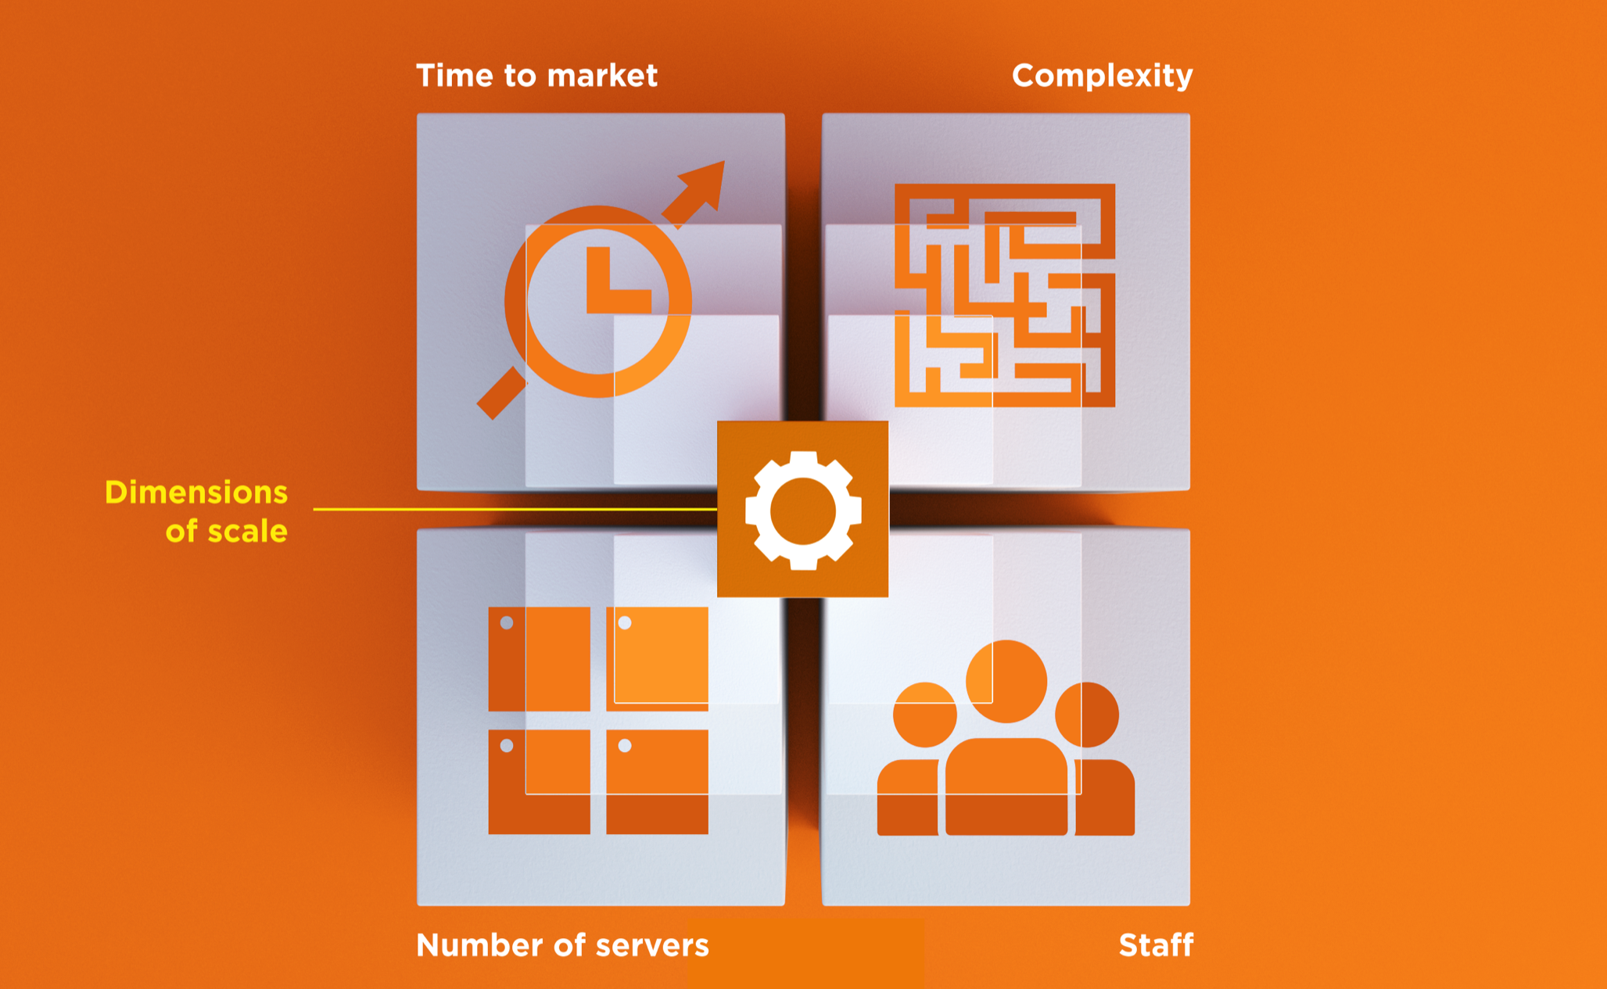
Dimensions of Scale

Slide 24
Automation Platform
Creates a dependable view of your entire network’s state.
Can handle complex dependencies among the nodes of your network.
Is fault tolerant.
Is secure.
Can handle multiple platforms
Can manage cloud resources
Provides a foundation for innovation

Slide 25
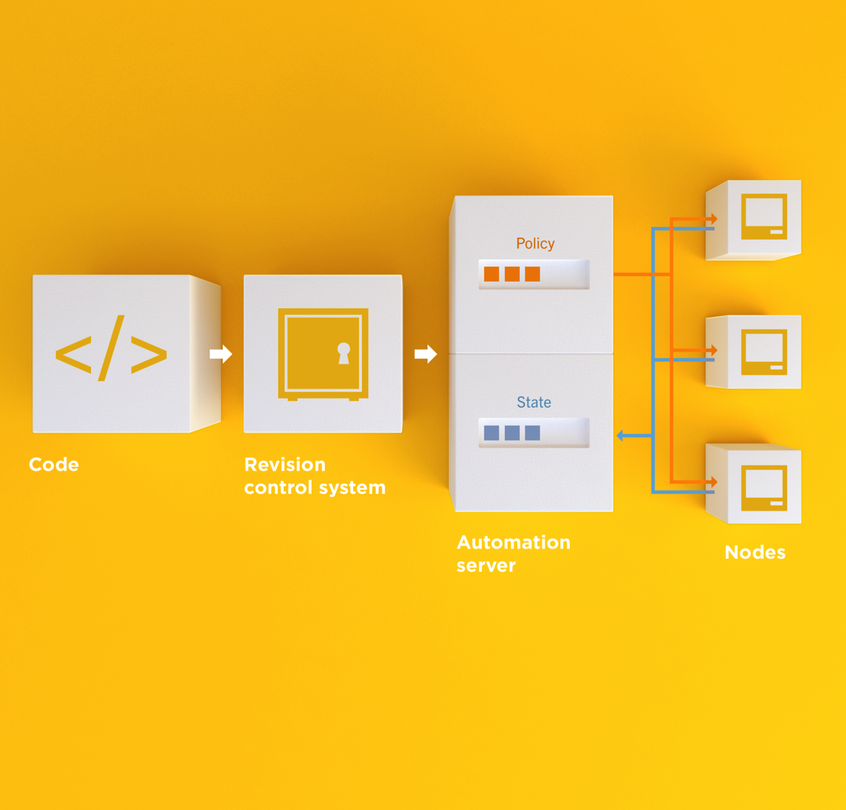
Infrastructure as Code
Programmatically provision and configure components
Notes:
Use the Chef framework and Chef programming language to define the components of your infrastructure. This allows you to capture and document the shape of your infrastructure in a consistent way.

Slide 26
Infrastructure as Code
Treat like any other code base
Notes:
Treat this like any other code base:
Store the code in a version control system.
Add automated tests to the code.
Refactor the code over time.
Build and version software artifacts (e.g. packages)
The code is executable documentation.
Store the code in a version control system.

Slide 27
Infrastructure as Code
Reconstruct business from code repository, data backup, and compute resources
Notes:
With your infrastructure now fully captured in code, you are now able to rebuild your entire business, well, at least all of your business’s applications, with your code repository, a backup of your data, and compute resources, be they bare metal, virtual machines, or cloud instances.

Slide 28
Infrastructure as Code
Programmatically provision and configure components
Treat like any other code base
Reconstruct business from code repository, data backup, and compute resources
Notes:
Stop for a minute and think about what we're saying here. Think about how freeing this can be. The next configuration change you need to make in production starts with a commit to your version control system. You can re-provision your infrastructure with another service provider; move from the data center to the clould and back again.How will this impact the way you run operations in your organization?What questions do you have?

Slide 29
Policy-based
You capture the policy for your infrastructure in code
A program ensures each node in your infrastructure complies with the policy
A control loop keeps the system stable and allows for change when policy is updated

Slide 30
Sample Infrastructure
Graphite
Nagios
Rails
Memcache
Postgres Slaves
Postgres Master

Slide 31
New Compliance Mandate!
Graphite
Nagios
Rails
Memcache
Postgres Slaves
Postgres Master

Slide 32
New Compliance Mandate!
Graphite
Nagios
Rails
Move SSH off of port 22
Let’s put it on 2022
Memcache
Postgres Slaves
Postgres Master

Slide 33
6 Golden Images to Update
Graphite
1
1
Nagios
1
1
1
1
1
Rails
1
1
Memcache
1
1
Postgres Slaves
1
Postgres Master

Slide 34
6 Golden Images to Update
Graphite
1
2
Nagios
3
Rails
/etc/ssh/sshd_config
--- a/sshd_config
+++ b/sshd_config
-Port 22
+Port 2202
4
Memcache
5
Postgres Slaves
6
Postgres Master

Slide 35
12 Instances to replace
Graphite
1
2
Nagios
3
4
5
6
7
Rails
Launch
Delete
Repeat
Typically manually
8
9
Memcache
10
11
Postgres Slaves
12
Postgres Master

Slide 36
Done in maintenance window
Graphite
1
2
Nagios
3
4
5
6
7
Rails
High stakes
Late hours
Risky change
8
9
Memcache
10
11
Postgres Slaves
12
Postgres Master

Slide 37
New configurations required?
Graphite
Nagios
Rails
Do the new instances have new IP Addresses?
* Not all connections shown
Memcache
Postgres Slaves
Postgres Master

Slide 38
Golden Images vs. Policy-based

Slide 39
Chef
Fast, scalable, flexible IT automation

Slide 40
What is Chef
Open source framework for managing complexity in your infrastructure through policy-driven automation code
A community of professionals
A company
Notes:
~60K professionals

Slide 41
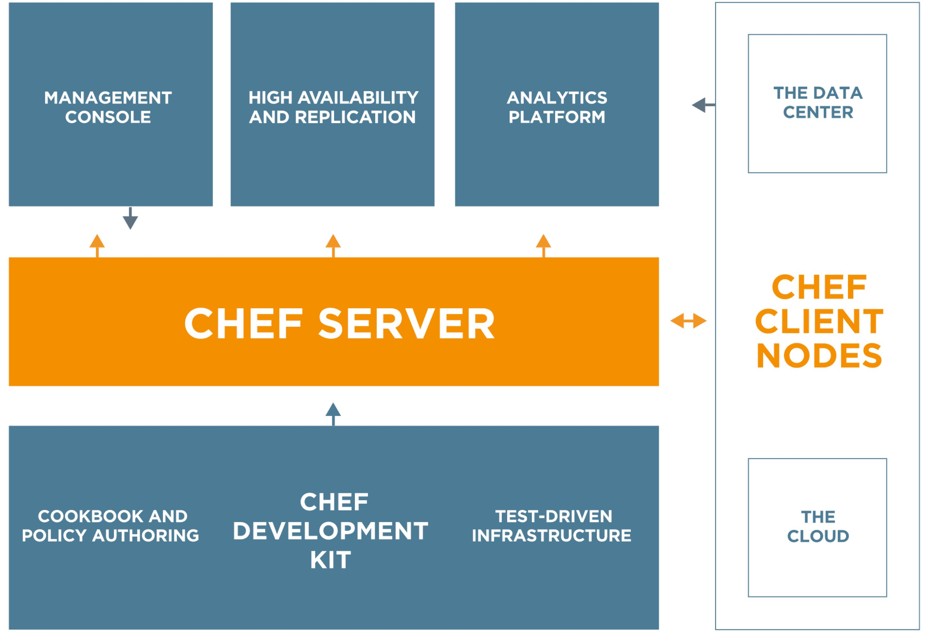
Chef
https://www.chef.io/chef/
Notes:
All Open Source!

Slide 42
Chef Server – Policy & State
Notes:
Policy –

Slide 43
Desired Configuration

Slide 44
Desired Configuration

Slide 45
Desired Configuration

Slide 46
Chef Server – Policy & State
Notes:
Policy –

Slide 47
HA Proxy Configuration

Slide 48
HA Proxy Configuration

Slide 49
HA Proxy Configuration

Slide 50
HA Proxy Configuration

Slide 51
HA Proxy Configuration

Slide 52
HA Proxy Configuration

Slide 53
HA Proxy Configuration

Slide 54
HA Proxy Configuration

Slide 55
HA Proxy Configuration

Slide 56
Building your policy
Resources and Recipes
Notes:
Policy is defined as a collection of resources in recipes. There are lots of abstractions on top of this but resources are the basic building blocks.

Slide 57
Resources
Piece of the system and its desired state

Slide 58
Resources - Package
Package that should be installed
package "mysql-server" do
action :install
end

Slide 59
Resources - Service
Service that should be running and restarted on reboot
service "iptables" do
action [ :start, :enable ]
end

Slide 60
Resources - Service
File that should be generated
file "/etc/motd" do
content "Property of Chef Software"
end

Slide 61
Resources - Cron
Cron job that should be configured
cron "restart webserver" do
hour '2'
minute '0'
command 'service httpd restart'
end

Slide 62
Resources - User
User that should be managed
user "nginx" do
comment "Nginx user <nginx@example.com>"
uid 500
gid 500
supports :manage_home => true
end

Slide 63
Resources - DSC
DSC resource that should be run
dsc_script 'emacs' do
code <<-EOH
Environment 'texteditor'
{
Name = 'EDITOR'
Value = 'c:\\emacs\\bin\\emacs.exe'
}
EOH
end

Slide 64
Resources – Registry Key
Registry key that should be created
registry_key "HKEY_LOCAL_MACHINE\\SOFTWARE\\Microsoft\\Windows\\CurrentVersion\\Policies\\System" do
values [{
:name => "EnableLUA",
:type => :dword,
:data => 0
}]
action :create
end

Slide 65
Resources
Piece of the system and its desired state
http://docs.chef.io/chef/resources.html

Slide 66
Lab – Install a text editor
Problem: Our workstation does not have $EDITOR installed
Success Criteria: You can edit files with $EDITOR
$EDITOR is your favorite command line text editor: vim, emacs, or nano

Slide 67
What’s up with the card?
http://bit.ly/posscon-workstations
Login: chef
Password: [REDACTED]

Slide 68
Login to your lab machine
ssh chef@54.164.75.30
The authenticity of host '54.165.227.226 (54.165.227.226)' can't be established.
RSA key fingerprint is c1:ec:ab:66:fb:22:4a:8f:c2:c5:9b:26:77:f3:dd:b3.
Are you sure you want to continue connecting (yes/no)? yes
Warning: Permanently added '54.165.227.226' (RSA) to the list of known hosts.
chef@54.165.227.226's password:

Slide 69
Welcome to your workstation
ChefDK version 0.4.0 is installed
chef --version
Chef user has passwordless sudo access
sudo cat /etc/shadow

Slide 70
Is $EDITOR installed?
which vim
/usr/bin/which: no vim in (/opt/chefdk/bin:/home/chef/.chefdk/gem/ruby/2.1.0/bin:/opt/chefdk/embedded/bin:/usr/local/bin:/bin:/usr/bin:/usr/local/sbin:/usr/sbin:/sbin:/home/chef/bin)

Slide 71
chef-apply
chef-apply is an executable program that allows you to work with resources
Is included as part of the ChefDK
A great way to explore resources
NOT how you’ll eventually use Chef in production

Slide 72
Install vim
sudo chef-apply -e "package 'vim'"
Recipe: (chef-apply cookbook)::(chef-apply recipe)
* package[vim] action install
- install version 7.2.411-1.8.el6 of package vim-enhanced

Slide 73
Install emacs
sudo chef-apply -e "package 'emacs'"
Recipe: (chef-apply cookbook)::(chef-apply recipe)
* package[emacs] action install
- install version 23.1-25.el6 of package emacs

Slide 74
Install nano
sudo chef-apply -e "package 'nano'"
Recipe: (chef-apply cookbook)::(chef-apply recipe)
* package[nano] action install
- install version 2.0.9-7.el6 of package nano

Slide 75
Resources
Describe the desired state
Do not need to tell Chef how to get there
What happens if you re-run the chef-apply command?

Slide 76
Install $EDITOR again with chef-apply
sudo chef-apply -e "package 'vim'"
Recipe: (chef-apply cookbook)::(chef-apply recipe)
* package[vim] action install (up to date)

Slide 77
Test and Repair
Resources follow a test and repair model
package "vim"

Slide 78
Test and Repair
Resources follow a test and repair model
package "vim"
Is vim installed?
Test

Slide 79
Test and Repair
Resources follow a test and repair model
package "vim"
Is vim installed?
Test
Yes

Slide 80
Test and Repair
Resources follow a test and repair model
package "vim"
Is vim installed?
Test
Yes
Done

Slide 81
Test and Repair
Resources follow a test and repair model
package "vim"
Is vim installed?
Test
Yes
No
Done

Slide 82
Test and Repair
Resources follow a test and repair model
package "vim"
Is vim installed?
Test
Yes
No
Done
Install it

Slide 83
Test and Repair
Resources follow a test and repair model
package "vim"
Is vim installed?
Test
Yes
No
Repair
Done
Install it

Slide 84
Resources – Test and Repair
Resources follow a test and repair model
Resource currently in the desired state? (test)
Yes – Do nothing
No – Bring the resource into the desired state (repair)

Slide 85
Resources
package
template
service
directory
user
group
dsc_script
registry_key
powershell_script
cron
mount
route
…and more!
Notes:
Of course, there are lots of different types of resources that come with Chef
View them all on docs.chef.io/resources.html

Slide 86
Hello, Chef!
~/hello_chef.rb
file "/tmp/hello_chef.txt" do
content "Hello, Chef"
mode "0777"
end

Slide 87
Apply the policy
sudo chef-apply hello_chef.rb
Recipe: (chef-apply cookbook)::(chef-apply recipe)
* file[/tmp/hello_chef.txt] action create
- create new file /tmp/hello_chef.txt
- update content in file /tmp/hello_chef.txt from none to 79c290
--- /tmp/hello_chef.txt 2014-10-22 19:59:04.000000000 -0400
+++ /tmp/.hello_chef.txt20141022-23075-19aelx1 2014-10-22 19:59:04.000000000 -0400
@@ -1 +1,2 @@
+Hello, Chef
- change mode from '' to '0777'

Slide 88
Resources
Describe the desired state
Do not need to tell Chef how to get there
What happens when you re-apply the policy?

Slide 89
Apply the policy
sudo chef-apply hello_chef.rb
Recipe: (chef-apply cookbook)::(chef-apply recipe)
* file[/tmp/hello_chef.txt] action create (up to date)

Slide 90
Resources
A piece of the system
Its desired state
file "/tmp/hello_chef.txt" do
content "Hello, Chef"
mode "0777"
end

Slide 91
Change the state of the system
echo “Hello, #posscon” > /tmp/hello_chef.txt

Slide 92
Apply the policy
sudo chef-apply hello_chef.rb
Recipe: (chef-apply cookbook)::(chef-apply recipe)
* file[/tmp/hello_chef.txt] action create
- update content in file /tmp/hello_chef.txt from e453df to 79c290
--- /tmp/hello_chef.txt 2014-10-22 20:00:20.000000000 -0400
+++ /tmp/.hello_chef.txt20141022-23340-17a7m5t 2014-10-22 20:00:50.000000000 -0400
@@ -1,2 +1,2 @@
-“Hello, #posscon”
+Hello, Chef

Slide 93
Resources – Test and Repair
Resources use a test and repair model
Resource currently in the desired state?
Yes – Do nothing
No – Bring the resource into the desired state (repair)

Slide 94
Built-in Resources
package
template
service
cron
directory
mount
user
group
registry_key
remote_directory
route
and many more…
docs.chef.io/chef/resources.html

Slide 95
Recipes
Policy is defined as a collection of resources in recipes. There are lots of abstractions on top of this but resources are the basic building blocks.

Slide 96
Install git
The package git should be installed
The file named '/home/chef/.gitconfig' should be created.
It should be owned by the chef user and group.
It should have the content:
[user]\n name=John Doe\n email=jdoe@example\n
Notes:
Give the students 5-10 minutes to complete this part of the lab.

Slide 97
Install git
~/git.rb
package 'git' do
action :install
end
file '/home/chef/.gitconfig' do
content "[user]\n name=John Doe\n email=jdoe@example\n"
user 'chef'
group 'chef'
end

Slide 98
Install git
sudo chef-apply ~/git.rb
Recipe: (chef-apply cookbook)::(chef-apply recipe)
* package[git] action install
- install version 1.7.1-3.el6_4.1 of package git
* file[/home/chef/.gitconfig] action create
- create new file /home/chef/.gitconfig
- update content in file /home/chef/.gitconfig from none to 259950
--- /home/chef/.gitconfig 2014-09-24 00:24:13.558127555 +0000
+++ /tmp/..gitconfig20140924-10180-1ij68vq 2014-09-24 00:24:13.559127555 +0000
@@ -1 +1,4 @@
+[user]
+ name=John Doe
+ email=jdoe@example.com
- change owner from '' to 'chef'
- change group from '' to 'chef'
- restore selinux security context

Slide 99
Test-driven Infrastructure
Change policy with confidence

Slide 100
Our process
Write policy
Apply policy
Verify policy
Not bad for the simple case, will quickly get untenable

Slide 101
Faster Feedback
Speed-up the feedback loops with automated testing.
Have confidence in your changes before you run them in production

Slide 102
Chef Testing
Did chef-client complete successfully?
Did the recipe put the node in the desired state?
Are the resources properly defined?
Does the code follow our style guide?

Slide 103
Test-driving infrastructure
We are going to use a relatively simple scenario
We are going to explore many facets of testing
We are going to follow a test-first, test-driven model

Slide 104
Our Scenario
We want a custom home page available on the web.

Slide 105
Create an apache cookbook
chef generate cookbook cookbooks/apache
Compiling Cookbooks...
Recipe: code_generator::cookbook
* directory[/home/chef/chef-repo/cookbooks/apache] action create
- create new directory /home/chef/chef-repo/cookbooks/apache
* template[/home/chef/chef-repo/cookbooks/apache/metadata.rb] action create_if_missing
- create new file /home/chef/chef-repo/cookbooks/apache/metadata.rb
- update content in file /home/chef/chef-repo/cookbooks/apache/metadata.rb from none to 4c0e2d
(diff output suppressed by config)
* template[/home/chef/chef-repo/cookbooks/apache/README.md] action create_if_missing

Slide 106
Questions to ask when testing
Did chef-client complete successfully?
Did the recipe put the node in the desired state?
Are the resources properly defined?
Does the code following our style guide?

Slide 107
Chef client success status
Requirements to verify chef-client success:
A place to store the cookbook artifact

Slide 108
Chef client success status
Requirements to verify chef-client success:
A place to store the cookbook artifact
A chef-client with access to the cookbook

Slide 109
Chef client success status
Requirements to verify chef-client success:
A place to store the cookbook artifact
A chef-client with access to the cookbook
A target server running the same OS as production

Slide 110

Test Kitchen
Test harness to execute code on one or more platforms
Driver plugins to allow your code to run on various cloud and virtualization providers
Includes support for many testing frameworks
Included with ChefDK

Slide 111
Test Matrix
Two operating systems
ubuntu-12.04
centos-6.4

Slide 112
Test Matrix
Two operating systems
One recipe
 | default
ubuntu-12.04 | apache::default
centos-6.4 | apache::default

Slide 113
Test Matrix
Two operating systems
Two recipes
 | default | ssl
ubuntu-12.04 | apache::default | apache::ssl
centos-6.4 | apache::default | apache::ssl

Slide 114
Test Matrix
Three operating systems
Two recipes
 | default | ssl
ubuntu-12.04 | apache::default | apache::ssl
centos-6.4 | apache::default | apache::ssl
ubuntu-14.04 | apache::default | apache::ssl

Slide 115
Configuring the Kitchen
apache/.kitchen.yml
---
driver:
name: vagrant
provisioner:
name: chef_zero
platforms:
- name: ubuntu-12.04
- name: centos-6.4
suites:
- name: default
run_list:
- recipe[apache::default]
attributes:

Slide 116
.kitchen.yml
driver - virtualization or cloud provider
---
driver:
name: vagrant
provisioner:
name: chef_zero
platforms:
- name: ubuntu-12.04
- name: centos-6.4
suites:
- name: default
run_list:
- recipe[apache::default]
attributes:

Slide 117
.kitchen.yml
provisioner - application to configure the node
---
driver:
name: vagrant
provisioner:
name: chef_zero
platforms:
- name: ubuntu-12.04
- name: centos-6.4
suites:
- name: default
run_list:
- recipe[apache::default]
attributes:

Slide 118
.kitchen.yml
platforms - target operating systems
---
driver:
name: vagrant
provisioner:
name: chef_zero
platforms:
- name: ubuntu-12.04
- name: centos-6.4
suites:
- name: default
run_list:
- recipe[apache::default]
attributes:

Slide 119
.kitchen.yml
suites - target configurations
---
driver:
name: vagrant
provisioner:
name: chef_zero
platforms:
- name: ubuntu-12.04
- name: centos-6.4
suites:
- name: default
run_list:
- recipe[apache::default]
attributes:

Slide 120
.kitchen.yml
 | default
ubuntu-12.04 | apache::default
centos-6.4 | apache::default
---
driver:
name: vagrant
provisioner:
name: chef_zero
platforms:
- name: ubuntu-12.04
- name: centos-6.4
suites:
- name: default
run_list:
- recipe[apache::default]

Slide 121
.kitchen.yml
 | default | ssl
ubuntu-12.04 | apache::default | apache::ssl
centos-6.4 | apache::default | apache::ssl
---
driver:
name: vagrant
provisioner:
name: chef_zero
platforms:
- name: ubuntu-12.04
- name: centos-6.4
suites:
- name: default
run_list:
- recipe[apache::default]
- name: ssl
run_list:
- recipe[apache::ssl]

Slide 122
.kitchen.yml
 | default | ssl
ubuntu-12.04 | apache::default | apache::ssl
centos-6.4 | apache::default | apache::ssl
ubuntu-14.04 | apache::default | apache::ssl
---
driver:
name: vagrant
provisioner:
name: chef_zero
platforms:
- name: ubuntu-12.04
- name: centos-6.4
- name: ubuntu-14.04
suites:
- name: default
run_list:
- recipe[apache::default]
- name: ssl
run_list:
- recipe[apache::ssl]

Slide 123
Move to the apache cookbook directory
cd ~/chef-repo/cookbooks/apache

Slide 124
Update .kitchen.yml
.kitchen.yml
---
driver:
name: docker
provisioner:
name: chef_zero
platforms:
- name: centos-6.5
suites:
- name: default
run_list:
- recipe[apache::default]
attributes:

Slide 125
List the Test Kitchens
kitchen list
Instance Driver Provisioner Last Action
default-centos-65 Docker ChefZero <Not Created>

Slide 126
Create the kitchen
kitchen create
-----> Starting Kitchen (v1.2.1)
-----> Creating <default-centos-64>...
Step 0 : FROM centos:centos6
---> 68eb857ffb51
Step 1 : RUN yum clean all
---> Running in cdf3952a3f18
Loaded plugins: fastestmirror
Cleaning repos: base extras libselinux updates
Cleaning up Everything
---> b1cccd25ce55
Removing intermediate container cdf3952a3f18
Step 2 : RUN yum install -y sudo openssh-server openssh-clients which curl
---> Running in 9db69ace459d
Loaded plugins: fastestmirror

Slide 127
Kitchen created
Workstation
Kitchen

Slide 128
Login to the kitchen
kitchen login
kitchen@localhost's password:

Slide 129
Login to the kitchen
kitchen login
kitchen@localhost's password:
kitchen

Slide 130
Login to the kitchen
kitchen login
kitchen@localhost's password:
Last login: Wed Sep 24 04:30:29 2014 from 172.17.42.1
kitchen

Slide 131
Kitchen login
Workstation
Kitchen

Slide 132
Kitchen login
Workstation
Kitchen
[chef@ip-172-31-44-173 apache]$ kitchen login

Slide 133
Kitchen login
Workstation
Kitchen
ssh
[chef@ip-172-31-44-173 apache]$ kitchen login

Slide 134
Kitchen login
Workstation
Kitchen
[kitchen@5379d310dc59 ~]$
ssh
[chef@ip-172-31-44-173 apache]$ kitchen login

Slide 135
Chef client success status
Requirements to verify chef-client success:
A target server running the same OS as production
A chef-client with access to the cookbook

Slide 136
Lab – Apply our policy
Problem: We have not applied our policy to the test environment.
Success Criteria: The default apache recipe will be applied in the test environment

Slide 137
Leave the kitchen
exit
logout
Connection to localhost closed.

Slide 138
Go to the right place
cd ~/chef-repo/cookbooks/apache

Slide 139
Apply our policy
kitchen converge
-----> Starting Kitchen (v1.2.1)
-----> Converging <default-centos-64>...
Preparing files for transfer
Resolving cookbook dependencies with Berkshelf 3.1.5...
Removing non-cookbook files before transfer
-----> Installing Chef Omnibus (true)
downloading https://www.getchef.com/chef/install.sh
to file /tmp/install.sh
trying curl...

Slide 140
Kitchen converge
Workstation
Kitchen
Install Chef
Upload cookbooks
Apply the run_list

Slide 141
Questions to ask when testing
Did chef-client complete successfully?
Did the recipe put the node in the desired state?
Are the resources properly defined?
Does the code following our style guide?

Slide 142
Verifying node state
Serverspec

Slide 143
Chef Testing
Did chef-client complete successfully?
Did the recipe put the node in the desired state?
Are the resources properly defined?
Does the code following our style guide?

Slide 144
Manually inspect the test node
kitchen login
kitchen@localhost's password:

Slide 145
Manually inspect the test node
kitchen login
kitchen@localhost's password:
kitchen

Slide 146
Manually inspect the test node
kitchen login
kitchen@localhost's password:
Last login: Wed Sep 24 04:30:29 2014 from 172.17.42.1
kitchen

Slide 147
Manually inspect the test node
curl http://localhost
curl: (7) couldn't connect to host

Slide 148
Kitchen login
Workstation
Kitchen
[kitchen@5379d310dc59 ~]$ curl http://localhost
curl: (7) couldn't connect to host
ssh
[chef@ip-172-31-44-173 apache]$ kitchen login

Slide 149
Lab – Verify node state
Problem: Manually verifying the state of the test node is tedious and error-prone.
Success Criteria: The end state of the node is automatically tested.

Slide 150

Serverspec
Write tests to verify your servers
Not dependent on Chef
Defines many resource types
package, service, user, etc.
Works well with Test Kitchen
http://serverspec.org/

Slide 151
Leave the Kitchen
exit
logout
Connection to localhost closed.

Slide 152
Move to the proper directory
cd ~/chef-repo/cookbooks/apache

Slide 153
Write a Serverspec test
test/integration/default/serverspec/default_spec.rb
require 'serverspec'
set :backend, :exec
describe 'apache' do
end

Slide 154
Generic Expectation Form
describe "<subject>" do
it "<description>" do
expect(thing).to eq result
end
end
Notes:
TODO: Use proper syntax / terms

Slide 155
Awesome Expectations
test/integration/default/serverspec/default_spec.rb
require 'serverspec'
set :backend, :exec
describe "apache::default" do
it "is awesome" do
expect(true).to eq true
end
end

Slide 156
Run the serverspec test
kitchen verify
-----> Running serverspec test suite
/opt/chef/embedded/bin/ruby -I/tmp/busser/suites/serverspec -I/tmp/busser/gems/gems/rspec-support-3.1.2/lib:/tmp/busser/gems/gems/rspec-core-3.1.7/lib /opt/chef/embedded/bin/rspec --pattern /tmp/busser/suites/serverspec/\*\*/\*_spec.rb --color --format documentation --default-path /tmp/busser/suites/serverspec
apache::default
is awesome
Finished in 0.02823 seconds (files took 0.99875 seconds to load)
1 example, 0 failures
Finished verifying <default-centos-64> (0m5.03s).

Slide 157
How would you test our criteria?
We want a custom home page available on the web.

Slide 158
What is success?
Package is installed?
Page is displayed?
What else?

Slide 159
Verify package is installed
test/integration/default/serverspec/default_spec.rb
require 'serverspec'
set :backend, :exec
describe "apache" do
it "is awesome" do
expect(true).to eq true
end
it "is installed" do
expect(package("httpd")).to be_installed
end
end
Notes:
add the it stanzas for the rest of the things and see them in a pending state
describe 'apache' do
…
it "is running"
it "is configured to run when the server reboots"
it "displays our home page"
it "returns a proper response code"
it "is listening on the proper port"
end

Slide 160
Exercise the test
kitchen verify
apache
is awesome
is installed (FAILED - 1)
Failures:
1) apache is installed
Failure/Error: expect(package("httpd")).to be_installed
expected Package "httpd" to be installed
/bin/sh -c rpm\ -q\ httpd
package httpd is not installed

Slide 161
Test is failing, make it pass
Test-driven development involves
Write a test to verify something is working
Watch the test fail
Write just enough code to make the test pass
Repeat

Slide 162
Update our cookbook
~/chef-reop/cookbooks/apache/recipes/default.rb
package "httpd"

Slide 163
Converge the node again
kitchen converge
-----> Converging <default-centos-64>...
Preparing files for transfer
Resolving cookbook dependencies with Berkshelf 3.1.5...
Removing non-cookbook files before transfer
Transfering files to <default-centos-64>
[2014-11-10T09:20:26+00:00] INFO: Starting chef-zero on host localhost, port 8889 with repository at repository at /tmp/kitchen
One version per cookbook
[2014-11-10T09:20:26+00:00] INFO: Forking chef instance to converge...
Starting Chef Client, version 11.16.4
[2014-11-10T09:20:27+00:00] INFO: *** Chef 11.16.4 ***
[2014-11-10T09:20:27+00:00] INFO: Chef-client pid: 571
...

Slide 164
Exercise the test
kitchen verify
apache
is awesome
is installed
Finished in 0.48165 seconds (files took 1.05 seconds to load)
2 examples, 0 failures
Finished verifying <default-centos-64> (0m5.64s).
-----> Kitchen is finished. (0m11.84s)

Slide 165
What else will you test?
Is the service running?
Is the port accessible?
Is the expected content being served?
Make sure everything works from a fresh kitchen, too!
Notes:
As the students answer the questions add tests to your serverspec. It might look something like this which will work and show the tests a “pending”
describe 'apache' do
it "is awesome" do
expect(true).to eq true
end
it "is installed" do
expect(package "httpd").to be_installed
end
it "is running"
it "is configured to run when the server reboots"
it "displays our home page"
it "returns a proper response code"
it "is listening on the proper port"
end

Slide 166

Time to hack!
https://www.flickr.com/photos/peterpearson/424047087
Notes:
Go!
Get started on your own, let’s check-in again in 20 minutes or so.
require 'serverspec'
require 'net/http' # required for the NET::HTTP test
set :backend, :exec
describe 'apache' do
it "is awesome" do
expect(true).to eq true
end
it "is installed" do
expect(package "httpd").to be_installed
end
it "is running" do
expect(service "httpd").to be_running
end
it "is configured to run when the server reboots" do
expect(service "httpd").to be_enabled
end
it "displays our home page" do
expect(command("curl http://localhost").stdout).to match /hello/i
end
it "returns a proper response code" do
expect(Net::HTTP.get_response(URI('http://localhost/index.html')).code).to eq "200”
expect(command('curl -sL -w "%{http_code}" "http://localhost" -o /dev/null').stdout).to eq "200” #man, that’s ugly! But it removes the requirement on net/http
end
it "is listening on the proper port" do
expect(port "80").to be_listening.with("tcp")
end
end

Slide 167
Extend the Serverspec test
test/integration/default/serverspec/default_spec.rb
describe 'apache' do
it "is installed" do
expect(package 'httpd').to be_installed
end
it "is running" do
expect(service 'httpd').to be_running
end
it "is listening on port 80" do
expect(port 80).to be_listening
end
it "displays a custom home page" do
expect(command("curl localhost").stdout).to match /hello/
end
end

Slide 168
Verify the kitchen
kitchen verify
apache
is installed
is running
is listening on port 80
displays a custom home page
Finished in 0.3968 seconds
4 examples, 0 failures
Finished verifying <default-centos-64> (0m4.25s).

Slide 169
Kitchen Workflow
kitchen create
kitchen converge
kitchen verify
kitchen destroy
All at once with kitchen test

Slide 170
Chef Testing
Did chef-client complete successfully?
Did the recipe put the node in the desired state?
Are the resources properly defined?
Does the code following our style guide?

Slide 171
Now for our new mandate
Update the tests
Watch them fail
Update the policy
See tests pass
Roll-out changes to production

Slide 172
Even Faster Feedback
ChefSpec

Slide 173
Chef Testing
Did chef-client complete successfully?
Did the recipe put the node in the desired state?
Are the resources properly defined?
Does the code following our style guide?

Slide 174
This is too slow!
To test our code, we need to spin up a test kitchen, converge a node, execute some tests.
Our simple test case takes about 2 minutes to fully execute.

Slide 175
Properly configured resources
We need a way to verify that the resources in our recipes are properly configured
We want to get faster feedback

Slide 176
Lab – Verify the resources
Problem: We should be able to catch errors before we need to converge a node
Success Criteria: Catch a typo prior to converge

Slide 177
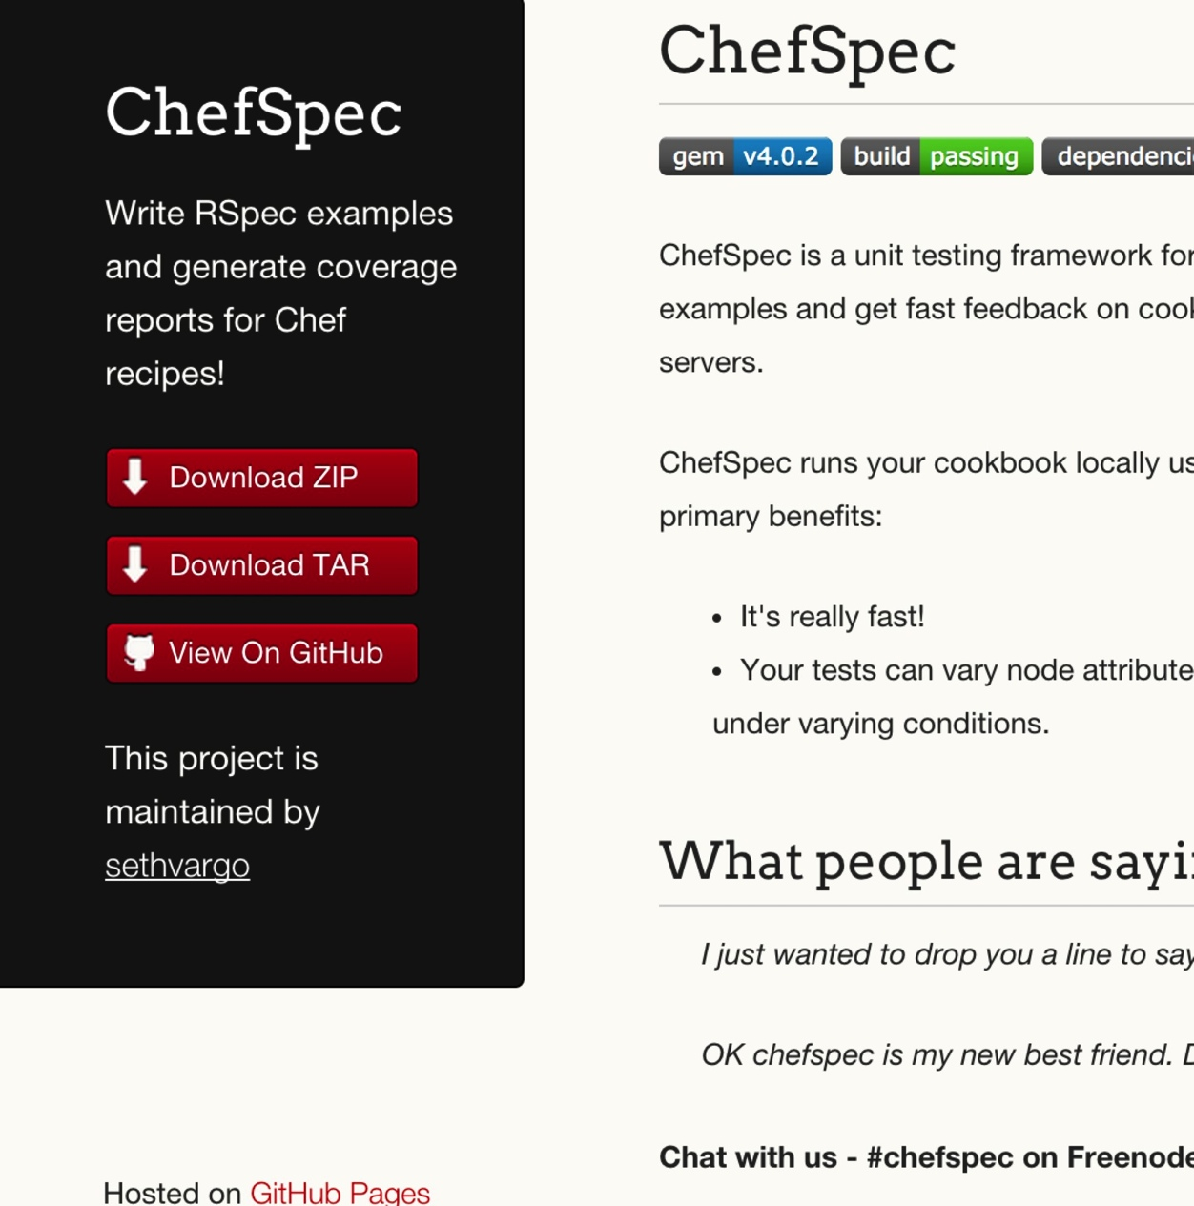
ChefSpec
Test before you converge
Get feedback on cookbook changes without the need for target servers
http://sethvargo.github.io/chefspec/

Slide 178
Make a directory for our ChefSpec tests
cd ~/chef-repo/cookbooks/apache
Notes:
~/chef-repo/cookbooks/apache/

Slide 179
Write a ChefSpec test
spec/unit/recipes/default_spec.rb
require 'spec_helper'
describe 'apache::default' do
context 'When all attributes are default, on an unspecified platform' do
let(:chef_run) do
runner = ChefSpec::ServerRunner.new
runner.converge(described_recipe)
end
it 'converges successfully' do
chef_run # This should not raise an error
end
end
end

Slide 180
Run the ChefSpec tests
rspec spec/unit/*.rb
.
Finished in 0.00865 seconds (files took 5.5 seconds to load)
1 example, 0 failures

Slide 181
Break the cookbook
recipes/default.rb
package "http"
service "httpd" do
action :start
end
template "/var/www/html/index.html" do
source "index.html.erb"
end

Slide 182
Run the ChefSpec tests
rspec spec/unit/*.rb
F
Failures:
1) apache::default installs apache
Failure/Error: expect(chef_run).to install_package('httpd')
expected "package[httpd]" with action :install to be in Chef run. Other package resources:
package[http]
# ./spec/unit/default_spec.rb:9:in `block (2 levels) in <top (required)>'
Finished in 0.00847 seconds (files took 4.85 seconds to load)
1 example, 1 failure
Failed examples:
rspec ./spec/unit/default_spec.rb:8 # apache::default installs apache

Slide 183
Fix the cookbook
recipes/default.rb
package "httpd"
service "httpd" do
action :start
end
template "/var/www/html/index.html" do
source "index.html.erb"
end

Slide 184
Time to hack!
https://www.flickr.com/photos/peterpearson/424047087
Notes:
Go!
Get started on your own, let’s check-in again in 20 minutes or so.

Slide 185
Chef Testing
Did chef-client complete successfully?
Did the recipe put the node in the desired state?
Are the resources properly defined?
Does the code following our style guide?

Slide 186
Clean code
Follow best practices, avoid mistakes

Slide 187

Foodcritic
Check cookbooks for common problems
Style, correctness, deprecations, etc.
Included with ChefDK
http://www.foodcritic.io/

Slide 188
Change our recipe
recipes/default.rb
package_name = "httpd"
package "#{package_name}"
service "httpd" do
action :start
end
template "/var/www/html/index.html" do
source "index.html.erb"
end

Slide 189
Run Foodcritic
foodcritic .
FC002: Avoid string interpolation where not required: ./recipes/default.rb:7

Slide 190
Chef Testing
Did chef-client complete successfully?
Did the recipe put the node in the desired state?
Are the resources properly defined?
Does the code following our style guide?

Slide 191
Wrapping Up

Slide 192
We’ve only scratched the surface
https://www.chef.io/chef/
Notes:
All Open Source!

Slide 193
Build Anything
Simple internal applications
Complex external applications
Workstations
Hadoop clusters
IaaS infrastructure
PaaS infrastructure
SaaS applications
Storage systems
You name it
http://www.flickr.com/photos/hyku/245010680/

Slide 194
And Manage it Simply
Automatically reconfigure everything
Linux, Windows, Unixes, BSDs
Load balancers
Metrics collection systems
Monitoring systems
Cloud migrations become trivial
http://www.flickr.com/photos/helico/404640681/

Slide 195
What questions do you have?
Ask me anything!
@nathenharvey
nharvey@chef.io
Thank you!

